Slide 1

Data Analysis
BUAD 621 Spring 2018
Makenzie Schulz
Daniel George
Mengwei Chen
Sai Nandiraju

Slide 2
When Life Gives You Lemons!
Hopefully you never have to read a Lemon Law for your state...but if you do!
Delaware Lemon Law
Your car will be classified as a lemon if it has a defect that doesn't meet the manufacturer's warranty and:
It has been out of service for a total of 30 days or longer. OR
At least 4 attempts have been made to fix the issue.
NOTE: The defect must occur within 1 year of purchasing the vehicle or within the warranty period.

Slide 3

What are Lemons Costing Carvana?
Studying Carvana data of 121,690 vehicles from 2001 to 2009
Carvana Inventory consists of Lemon, Non-Lemon and Null Cars
Number of Lemons in Inventory is close to 9000 which is 12% of total cars
These 9000 lemons account to $56 million in lost profit
approximately 72% of Total Profit
Therefore it is crucial that Carvana is accurately able to predict loss due to Lemons!

Slide 4
How Do You Identify a Lemon?
We conducted observations and chose variables that were influential to the data
Used these features to develop a model used for lemon prediction
We optimized the model by adding and removing predicted features; seeing if they were influential to the sensitivity and selectivity of the model
This model will successfully save money due to lemon purchases.

Slide 5
Finding the Variables
Wheel Type
Auction House: Lemons vs. Profit
Inventory of Makes
Make vs. Avg Profit
Total Profit by Make
Odometer Results: Odometer Readings in relation to Lemon
Vehicle Age vs. Lemon
Vehicle Cost vs. Lemon

Slide 6
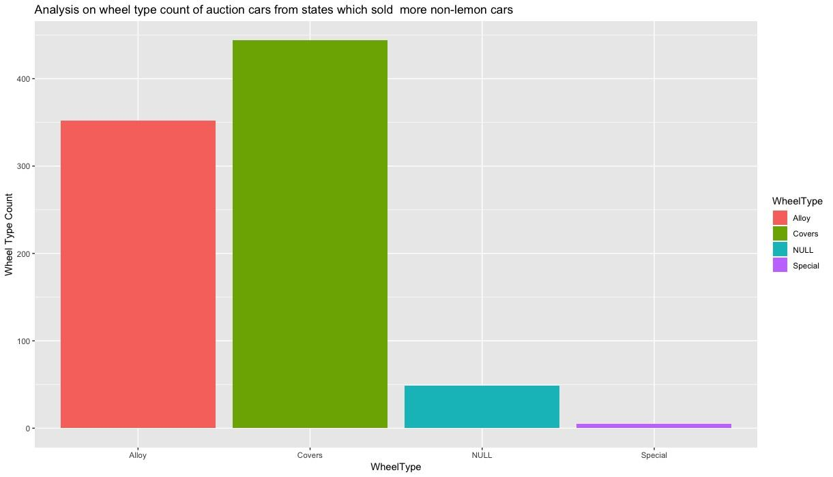
Alloy Wheel Type
Pros of Wheel Type: Alloy wheels are much lighter than steel wheels, which allows them to operate at a higher performance in most conditions.
Cons of Wheel Type: The main disadvantage of alloy wheels is their durability. When impacted by the road, alloy wheels tend to bend and even crack more easily than tougher steel wheels.

Slide 7
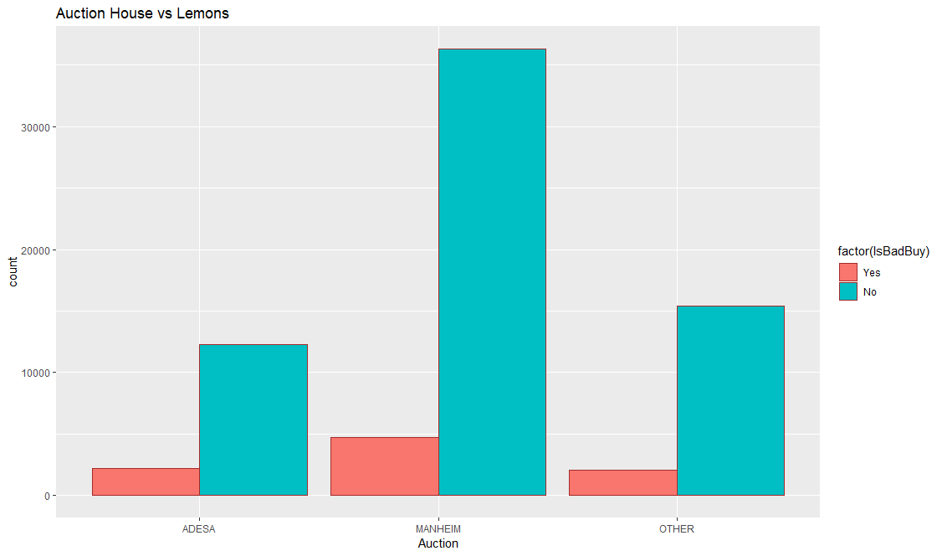
No notable difference observed between the Auction House when it came to relative quantity of lemons purchased

Slide 8
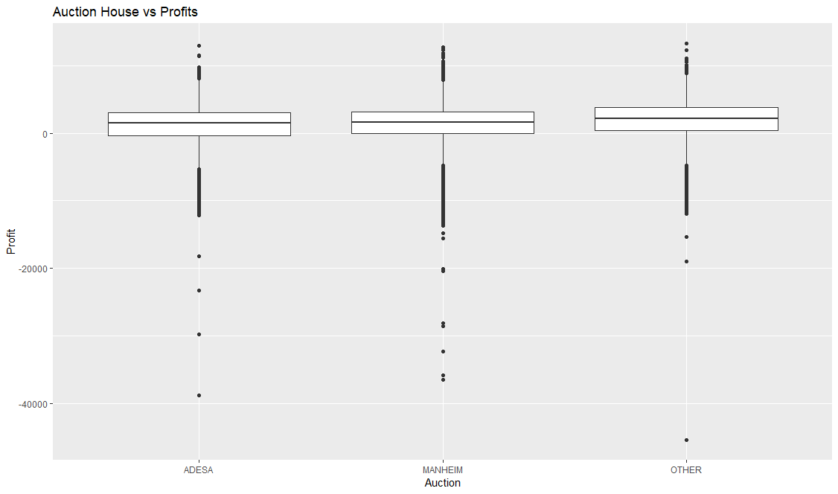
No notable difference observed between the Auction House when it came to potential realizable profits (current retail price – actual cost paid).

Slide 9
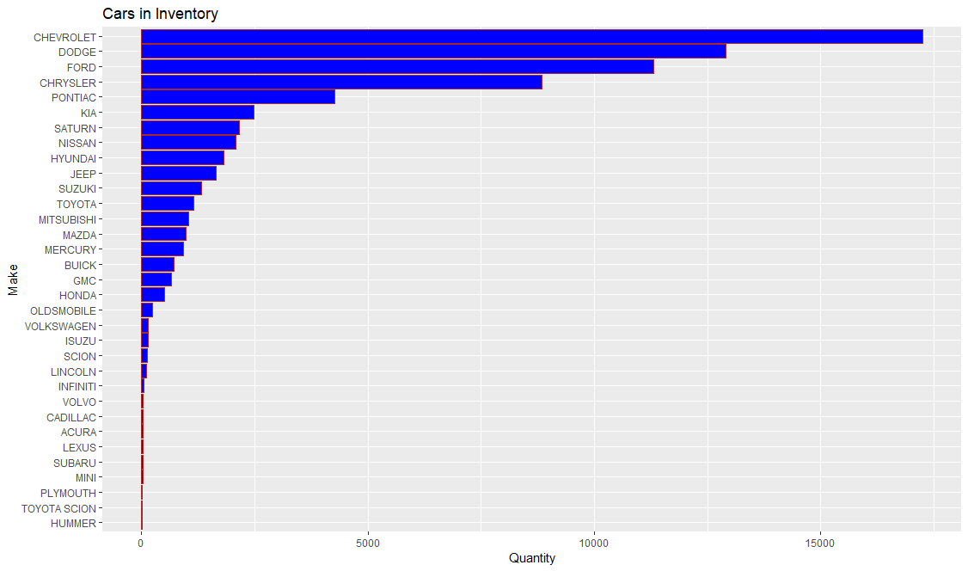
Inventory consisted of mostly Chevrolet, Dodge, Chrysler, and Ford cars

Slide 10
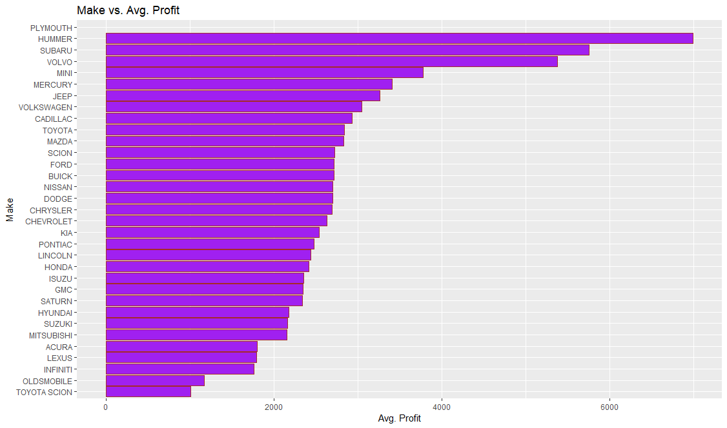
Highest inventory of cars were in the mid range for average profitability

Slide 11
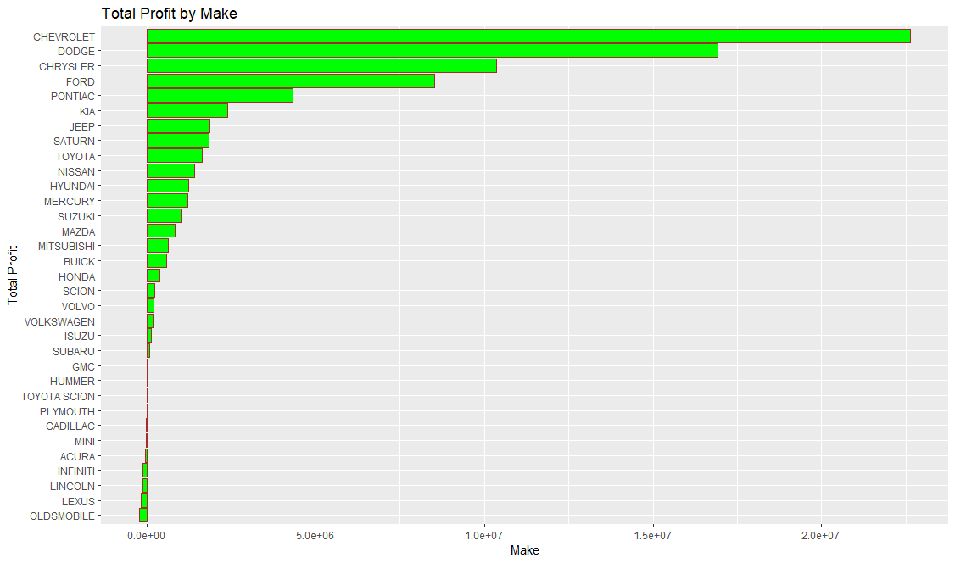
The total profit trend shows substantial profit concentrated in top 4 vehicles in inventory

Slide 12
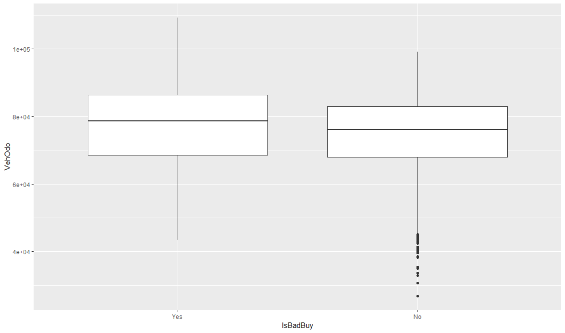
Odometer Results for Lemons
Lemon vs Odometer reading: Noticed a slight trend, nothing substantial

Slide 13
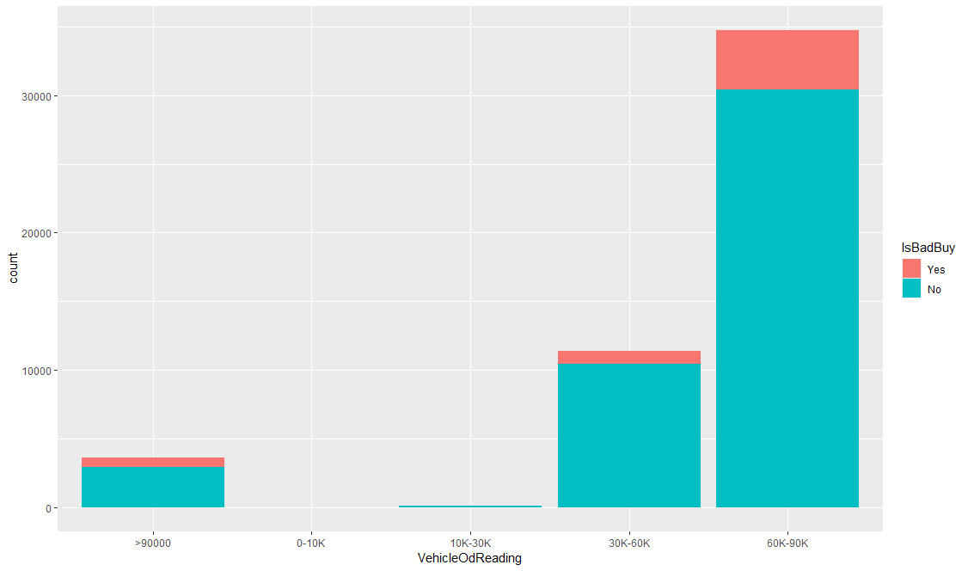

Slide 14
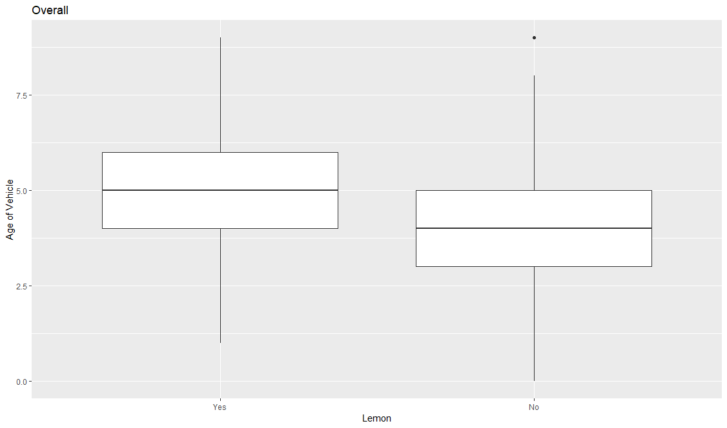
Vehicle Age vs. Lemon
A noticeable shift in mean is observed indicating that higher the vehicle age, high possibility of it being lemon.

Slide 15
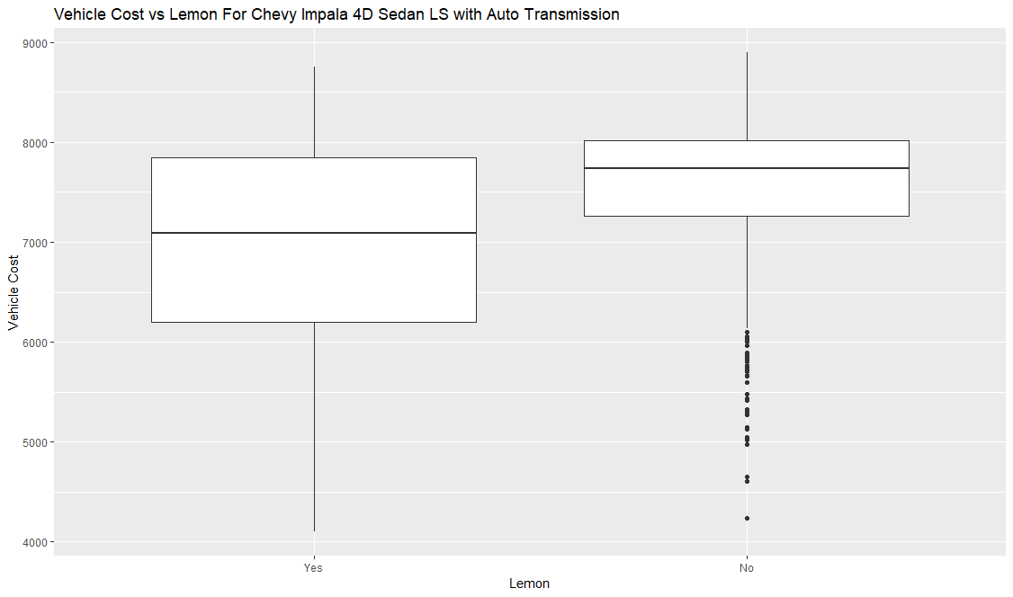
Actual Cost of Vehicle
After segmenting the data to specific vehicle types, looked at Lemon vs Actual Cost of Vehicle. Noticeable shift observed indicating higher chance of lemon with lower vehicle cost

Slide 16
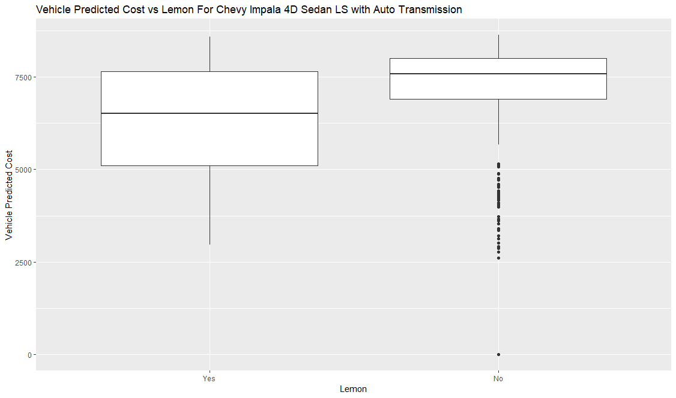
Vehicle Predicted Cost also shows similar trend in identifying Lemons.

Slide 17
Prediction Modeling
First Attempt at Prediction Model:
Decided to use 7 parameters:
Make, Retail Price, Vehicle Age, OD, Vehicle Cost, Predicted Cost and Wheel Type as factors for determining Lemon.
Variables were chosen due to verified trends, with consideration to total inventory, and number of lemons. These factors yield a promising trend.

Slide 18
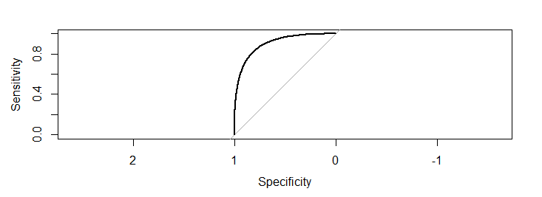
Lemon ~ VehicleAge
+ Make
+ VehOdo
+ VehBCost
+ MMRCurrentRetailAveragePrice,
+ MMRAcquisitionAuctionAveragePrice,
+ WheelType,
All seven variables measured in model
PredLemon PredNonLemon No 1237 62770 Yes 3585 5391

Slide 19

Lemon ~ VehicleAge
+ Make
+ VehOdo
+ VehBCost
+ MMRCurrentRetailAveragePrice,
+ MMRAcquisitionAuctionAveragePrice,
#+WheelType,
Wheel Type removed from Model
PredLemon PredNonLemon No 1074 62933 Yes 3233 5743

Slide 20

Lemon ~ VehicleAge
#+ Make
+ VehOdo
+ VehBCost
+ MMRCurrentRetailAveragePrice,
+ MMRAcquisitionAuctionAveragePrice,
#+ WheelType,
Wheel Type and Make removed from Model
PredLemon PredNonLemon No 1042 62965 Yes 3491 5485

Slide 21

Lemon ~ VehicleAge
#+ Make
+ VehOdo
+ VehBCost
#+ MMRCurrentRetailAveragePrice,
+ MMRAcquisitionAuctionAveragePrice,
#+ WheelType,
Make, Wheel Type and Retail Avg. Price removed from Model
PredLemon PredNonLemon No 1153 62854 Yes 3286 5690

Slide 22
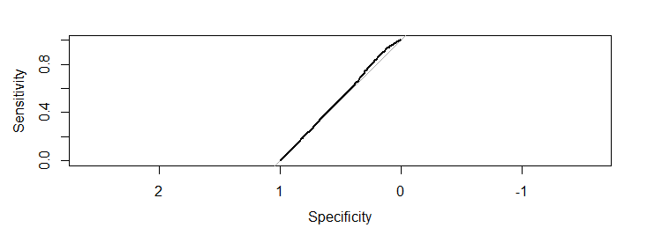
Lemon ~ VehicleAge
#+ Make
+ VehOdo
+ VehBCost
#+ MMRCurrentRetailAveragePrice,
#+ MMRAcquisitionAuctionAveragePrice,
#+ WheelType,
Wheel Type, Make, Retail Avg. Price and Acquisition price removed from Model
PredLemon PredNonLemon No 964 63043 Yes 142 8834

Slide 23
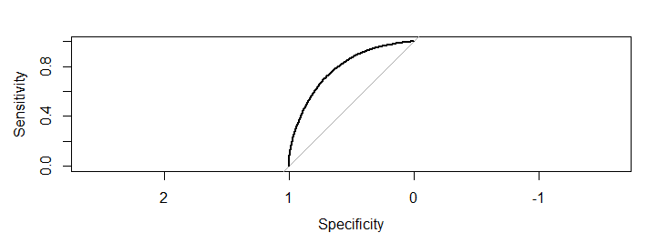
Lemon ~ VehicleAge
# + Make
#+ VehOdo
+ VehBCost
#+ MMRCurrentRetailAveragePrice,
+ MMRAcquisitionAuctionAveragePrice,
#+ WheelType,
Wheel Type, Make, Retail Avg. Price and Odometer removed from Model
PredLemon PredNonLemon No 1294 62713 Yes 1517 7459

Slide 24
Lemon ~ VehicleAge
#+ Make
+ VehOdo
+ VehBCost
#+ MMRCurrentRetailAveragePrice,
+ MMRAcquisitionAuctionAveragePrice,
#+ WheelType,
Four features were kept
PredLemon PredNonLemon No 1153 62854 Yes 3286 5690

Slide 25
PredLemon PredNonLemon No 2182 61825 Yes 4255 4721
threshold=0.4
threshold=0.3
PredLemon PredNonLemon No 4196 59811 Yes 5383 3593

Slide 26
threshold=0.2
PredLemon PredNonLemon No 8334 55673 Yes 6694 2282
threshold=0.1
PredLemon PredNonLemon No 19102 44905 Yes 8044 932

Slide 27
First Attempt Test Model
threshold | true pos | false pos | true pos rate |  | threshold | true neg | false neg | true neg rate | Used features
0.5 | 3585 | 5391 | 0.40 |  | 0.5 | 62770 | 1237 | 0.98 | 7
0.5 | 3233 | 5743 | 0.36 |  | 0.5 | 62933 | 1074 | 0.98 | 6
0.5 | 3491 | 5485 | 0.39 |  | 0.5 | 62965 | 1042 | 0.98 | 5
0.5 | 3286 | 5690 | 0.37 |  | 0.5 | 62854 | 1153 | 0.98 | 4
0.4 | 4255 | 4721 | 0.47 |  | 0.4 | 61825 | 2182 | 0.97 | 4
0.3 | 5383 | 3593 | 0.60 |  | 0.3 | 59811 | 4196 | 0.93 | 4
0.2 | 6694 | 2282 | 0.75 |  | 0.2 | 55673 | 8334 | 0.87 | 4
0.1 | 8044 | 932 | 0.90 |  | 0.1 | 44095 | 19102 | 0.70 | 4

Slide 28
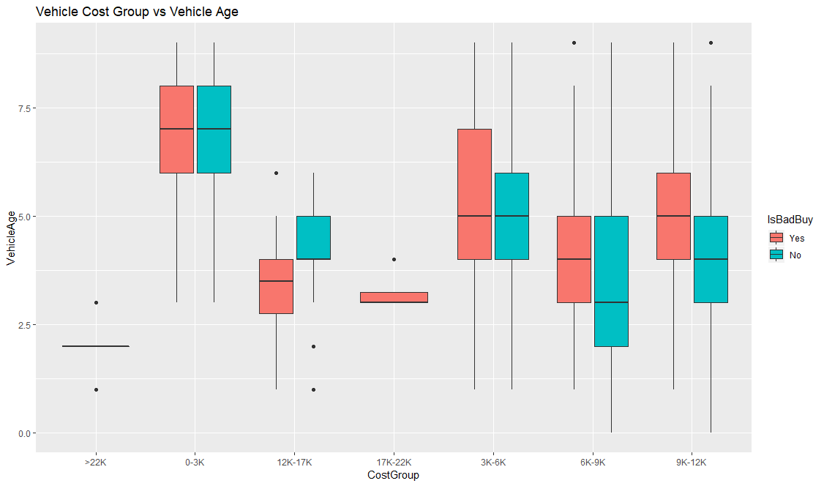
Compared Vehicle Cost Group as a subfactor to Age and noticed a substantial shift between lemon and non-lemon cars.

Slide 29
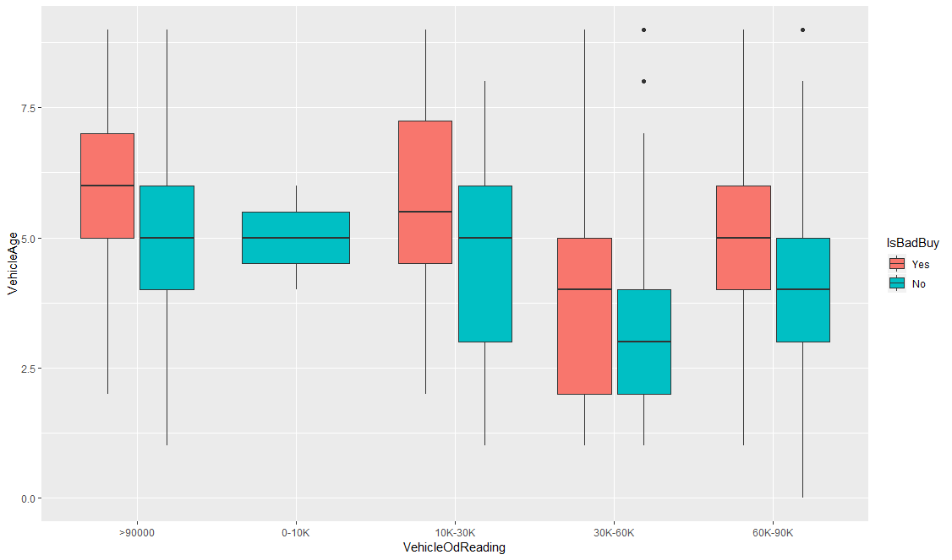
Vehicle Odometer Reading vs. Age
Compared Vehicle Odometer Reading as a subfactor to Age and noticed a substantial shift between lemon and non-lemon cars.

Slide 30
Second Analysis - 3 Factors Only
Since our boxplots showed a trend for lemon when using all the above factors. We wanted to explore this data in a different method.
Used Age as main factor, with cost and Odometer readings as sub-factor to age.
First method proved unsuccessful due to many existing pockets of variation between the three factors.
To eliminate such variations, a relativity index was used for prediction.
Vehicle Age was factored relative to Odometer reading, and Vehicle Actual Cost, since all factors shift heavily around age.
The new factored relative indices were used for this second analysis.

Slide 31
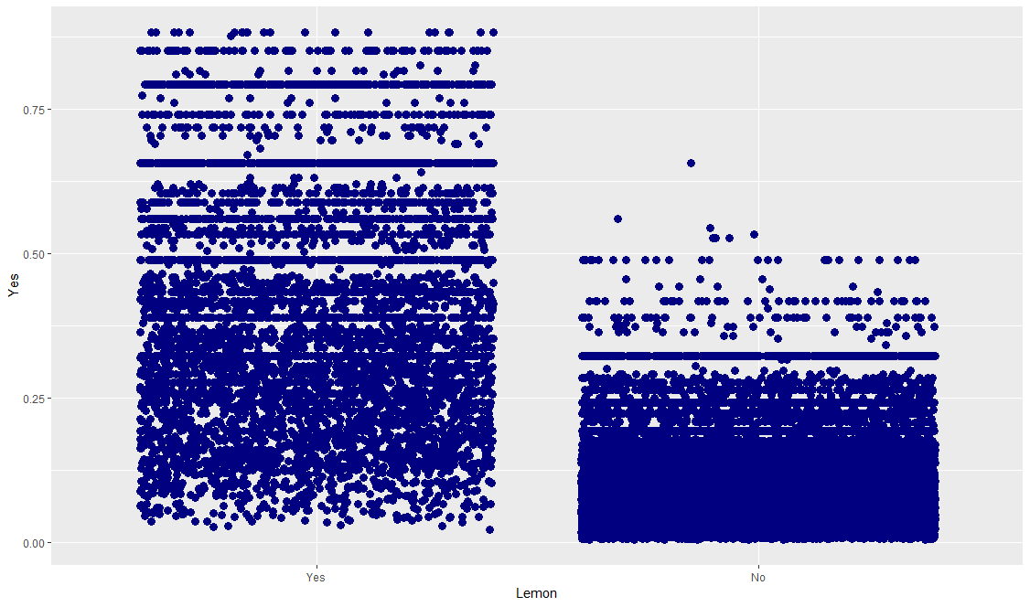
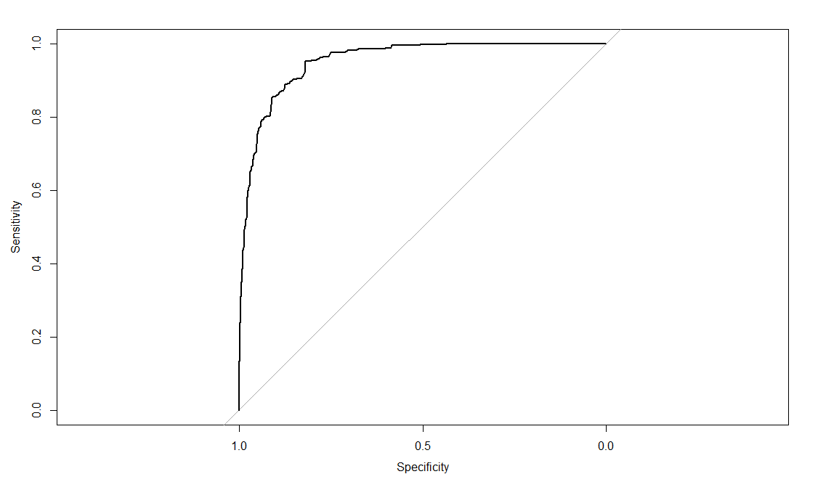
Second Analysis Yield
Prediction Model this time yield an outcome where our prediction were much closer to Actual

Slide 32
Second Analysis Yield Interpretation
Predicted Lemon Predicted Non-Lemon
Yes 5409 641
No 6027 38093
Based on a threshold of 15% above which all Vehicles are predicted as a lemon.
We were able to predict 89% of lemon vehicles as lemon.
On the other hand 86% of Non-Lemons were predicted accurately

Slide 33
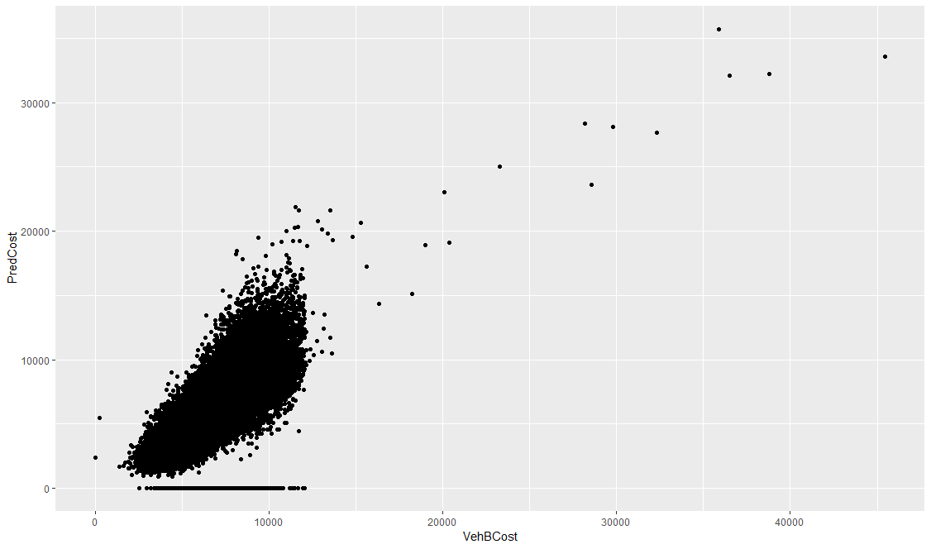
Third Model - Predicted vs Actual Cost
For the third model wanted to encompass all data, and utilize predicted cost as opposed to actual cost. So created similar indices for predicted cost (Logic being it is already available prior to purchase of vehicle)
From plotting actual vs. predicted cost, a fairly linear relationship was noticed, which grants us the idea that it can be used in place of actual cost.

Slide 34
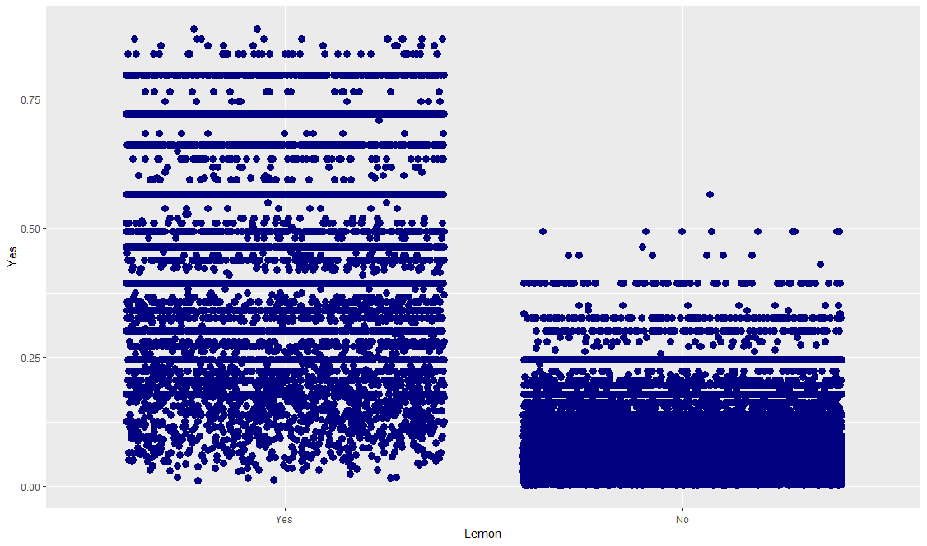
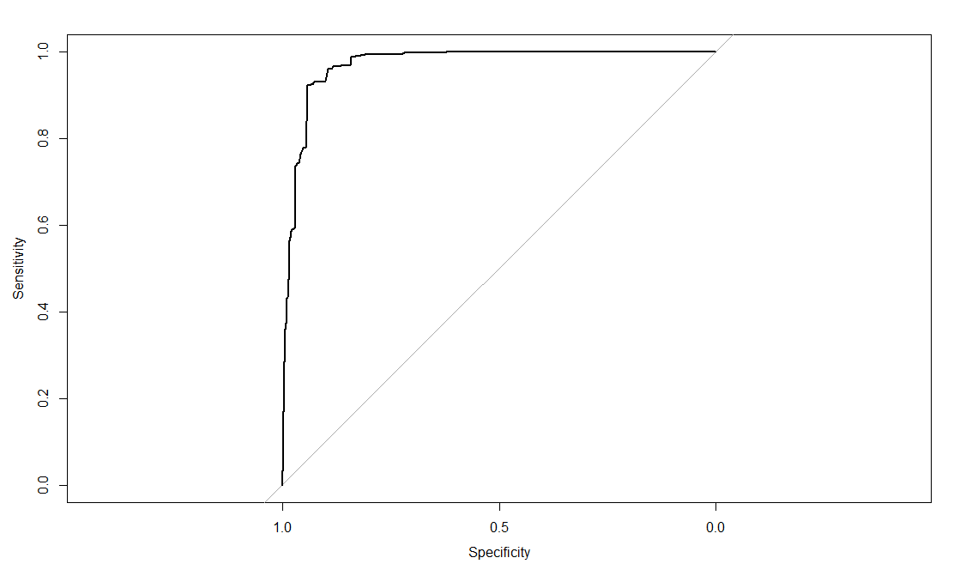
Third Analysis Yield
Prediction Model this time yield an outcome where our prediction were even closer to Actual

Slide 35
Third Analysis Yield Interpretation
Predicted Lemon Predicted Non-Lemon
Yes 8408 567
No 4927 59063
Based on a threshold of 15% above which all Vehicles are predicted as a lemon.
We were able to predict 94% of lemon vehicles as lemon.
On the other hand 92% of Non-Lemons were predicted accurately.
This would come out to greater than $41million in potential savings if applied to future compound of similar inventory.

Slide 36
Conclusion
We modeled a prediction based on Carvana’s prediction of cost of vehicle, Age of Vehicle, and the Odometer Reading in Vehicle.
Vehicle Age, and Vehicle Cost were found to have a huge influence on vehicle being lemon.
Vehicle predicted cost was a variable chosen due to its availability with Carvana prior to purchase of vehicle.
This model, when tested, predicted Lemon cars with 94% accuracy, and non-Lemon cars with 92% accuracy.
Current inventory of Carvana, with inclusion of Lemons, shows to yield a total profit of approximately $78mil.
If carvana were to use this model, there is potential to yield more than $41mil in savings, which could have potentially boosted their profitability to $119mil.

Slide 37
Thank You!
Questions are Welcome

Slide 38
References
Delaware Lemon Law: https://www.dmv.org/de-delaware/automotive-law/lemon-law.php
Alloy Wheel Type: https://www.blackburnwheels.com/alloy-wheels-vs-steel-wheels-pros-cons-guide/
10 Most Popular Car Colors: https://www.forbes.com/sites/matthewdepaula/2012/12/21/top-10-most-popular-car-colors/#50f37c777c80

